Slide 1
edU: Iteration 1
Zachery Gentry, Tousar Mohammed, Giannina Pachas and Courtney Howland

Slide 2

Exciting Features and Implementation
Drawing Pad [In iteration 1]
Shape Recognition [In iteration -2]
Letter Recognition [In iteration 2]
Number Recognition [In iteration 2]
Audio [In iteration 2]
Update Lesson List [After iteration 3]
View Lesson History [In iteration 3]
Difficulty Levels [In iteration 3]
(Picture 1)

Slide 3
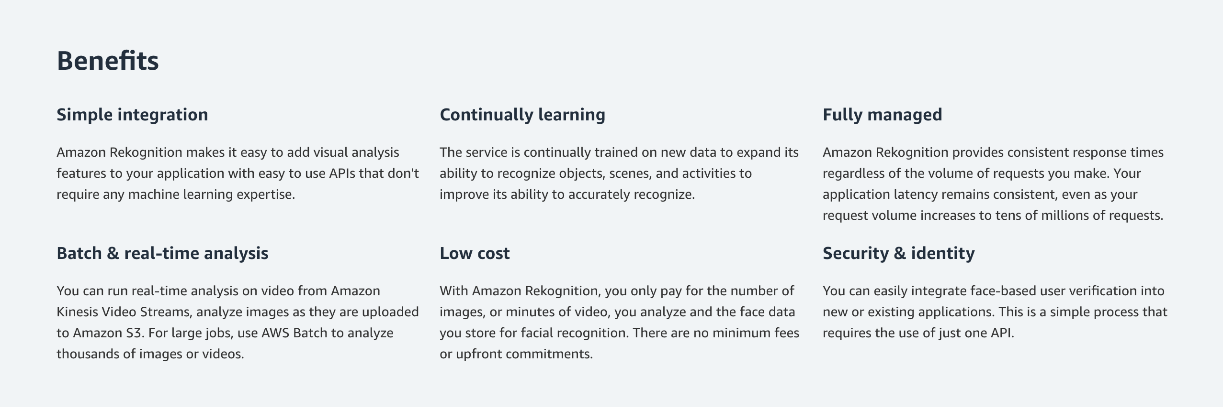
Changes to project
Amazon Rekognition
React-native sound
(Picture 2)

Slide 4
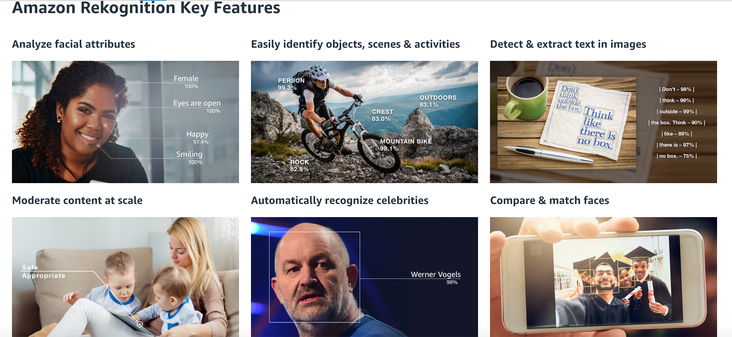
(Picture 3)

Slide 5
New Risks
Risk 1: Making the app visually appealing to a younger audience.
Risk Exposure: RE = 90% * 9hr = 8.1hr
Solution: use fun, bright colors and images to keep the student captivated and engaged
Risk 2: A few team members have busy schedules, making frequent meetings difficult.
Risk Exposure: 60% * 3hr = 1.8hr
Solution: The team will each write down their schedule.

Slide 6

Addressing our Review Team
Question 1: After developing the app how do you analyze the productivity? You guys are planning to have ​5 lesson plans as. Do you have any test subjects who goes through all the lessons and determine if its really helpful?
Question 2: Will the app have login functionally? If so, will the account be under the child or their parent? If not, how will you guys keep track of the users progress.
(Picture 4)

Slide 7
Demo

Slide 8
Resources
https://blog.membee.com/2015/01/sneak-peak-at-2015.html (Picture 1)
https://aws.amazon.com/rekognition/ (Picture 2-3)
http://www.pcyc.org.au/Clubs/Redlands/Basketball/Juniors.aspx (Picture 4)

